Slide 1

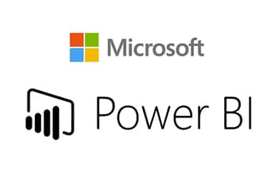



Slide 2
Concept Building
Suppose there is a company which sells automobile parts to 30+ cities in Pakistan. Lets name this company as “Crown”
Let’s suppose this company has a functional centralized database system, through which the receipt has been given to the vendor through agents.
Suppose this company has very strong hierarchy in terms of sales.

Slide 3






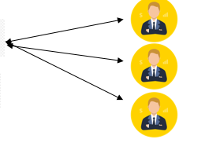

So that there is a Sales Manger, 30+ CitySalesManger reports to Sales Manger.
Each CitySalesManger have their agents named as sales agents for respective markets in respective regions.
CEO
Sales Manager
Area Sales Agent
CitySales Manager

Slide 4
Problem Statement
Now the problem arises; Sales in Pakistan got dropped phenomenally low. CEO got pretty worried about this, as Pakistan is their biggest market. So he called sales manager for the meeting.
CEO gives strict instructions to dig into the matter and give me the answers about where we got wrong ?
Give me the reports about sales in last couple of years, last couple of months of each market we deal in Pakistan in one week, He added.

Slide 5
Sales Manager immediately calls all the CitySales Mangers for a meeting soon after his meeting ended.
We will give all details of each market we cover the ay after tomorrow, All CitySales Manger said.
This brings a sigh of relief to Sales Manager and he ended the meeting.
Day after tomorrow the meeting has held but one thing gives almost a heart attack to the sales manager, what was that ? Will cover up in next video

Slide 6
All the City Sales Manger were there with an excel file in their USB, There were like 72+ excel files of order performances in each market in Pakistan.
How can I work on all these 72+ files in such a short time period, He shouted angrily.
He ended up the meeting and start work on these excel file one by one. He needed a presentation where there are beautiful charts gives the sales representation of each market every year.
As he starts working on these excel sheets he realized that there are some fake records as well which is being added by any of these City sales manager to sugar coat the sales report.

Slide 7
Now he got freaked out. Next day, He call his friend who runs data analytics firm and his friend calls him to his office.
I need a presentation having beautiful bar graphs, line charts and all without any sugar coated values in it. It should be based on real values, He said.
Do you have a centralized database of you company ? His friend asked. Yes, He answered.
His friend smiled and said now there is only one way out for you my friend, Creating a Dashboard on Business Intelligent Tool.

Slide 8
Do you have analytical team in you office ? His friend asked, No He replied.
Then you need to outsource it obviously, I have a team named as “Data Scavengers”, they are expert in data analytics you can take it.
Oh thankyou this will be a great help to me. Sales Manger Replied.
Next day Sales manager schedule a meeting for brainstorming, and to get most out of this project.

Slide 9
There were all stakeholders in the meeting. Director Sales Mangers, Sales Manager, Data scavengers team, Crown’s IT team and marketing team.
First of all we need to be very clear about the purpose of this project and to understand that we have very limited time to complete this project, Sales Manger said.
We need Sales Insights for decision support & automate the process to reduce manual time spent on data gathering/ data entry.
Secondly, all in this room are direct/indirect stakeholders of this project.

Slide 10
An automated dashboard which provides quick and latest sales insights in order to support data driven decision making.
After the meeting ended, they all were clear about the purpose and end result of the project.
Now, data scavengers team meet with crown’s IT team (Named as Covalent) and questioned about their system.
Crown has a simple software or sales management system that keeps track of each sales, all records are being stored in MySQL database, IT guy explained.

Slide 11
That’s great we need to use this MySQL database as it has all the records which we need for analytics.
We will use this database, apply ETL and build our tableau dashboard on top of it.
Ok go ahead, replied by covalent team member.

Slide 12
This leads to a very important concept: Data Warehousing Concept:
In real world when the data volume is high, you have to make sure that MySQL database is not effected by queries on BI tools. For this purpose we design a data warehouse.
According to this concept, you have to take the data from MySQL or known as OLTP (Online Transaction Processing System), then you can apply some ETL (Extract Transform Load) operations and then stored it to data ware house.

Slide 13
Data warehousing is being done primarily for 2 purposes:
1. If you queries slows down OLTP, then your sales operations will be effected.
2. Data in OLTP is not in a format you want for data analytics, So you need to do ETL. Like removing unwanted Columns/Rows, Remove duplicate data, and all. Once these ETL have been done successfully data will be now in “OLAP” (Online Analytical Processing), which is perfect for data analytics.

Slide 14
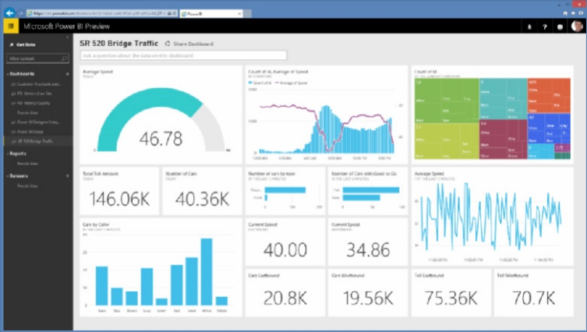
Data Mining
Sales Management System
ETL
MySQL
Data Warehousing
OLTP
OLAP
ETL
BI Tool

